Slide 1
Evolution
Evolutionary medicine

Slide 2
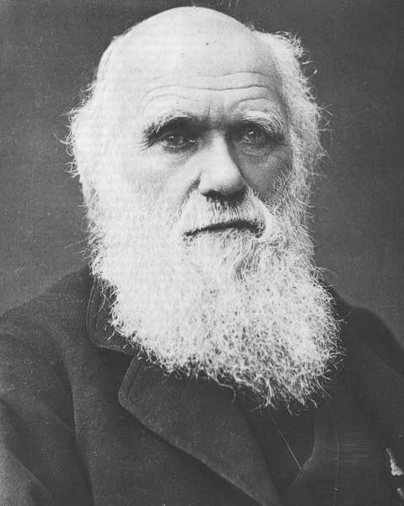
Evolution and human health
The analytical tools evolutionary biologists use to study form and function of organisms can—with appropriate caution— also be applied to study form and function of humans.
Evolving pathogens
Characters influenced by heterozygote advantage
Conditions caused by recessive alleles
Cancer as a consequence of mutation/selection balance
Inbreeding depression
Parent/offspring conflicts and kin selection
Aging as a consequence of tradeoffs between reproduction and repair

Slide 3
Evolutionary medicine in four acts
Why we age… and die… :(
Maladaptation and diseases of civilization
Epidemiology and managing pathogen evolution
Antibiotics and evolving superbugs

Slide 4
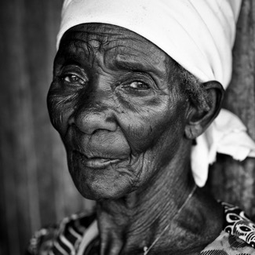
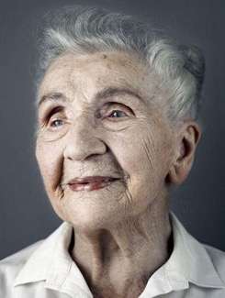
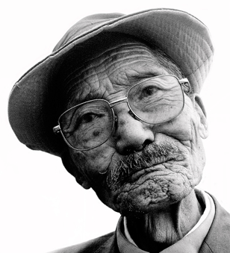
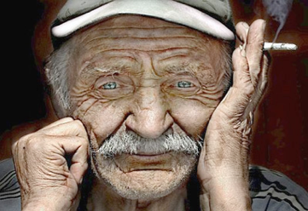
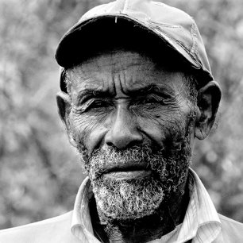

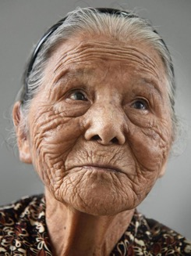
Why we age and die
Rate of living theory
Evolutionary theories of aging
Mutation accumulation hypothesis
Antagonistic-pleiotropy hypothesis

Slide 5
Rate of living theory
Aging as a consequence of accumulation of irreparable damage to cells and tissues
Predictions
Because cell and tissue damage is caused in part by the by-products of metabolism, the aging rate should be correlated with metabolic rate
Because organisms have been selected to resist and repair damage to the maximum, species should not be able to evolve longer life spans
Test 1
All species should expend about the same amount of energy per gram per lifetime!

Slide 6
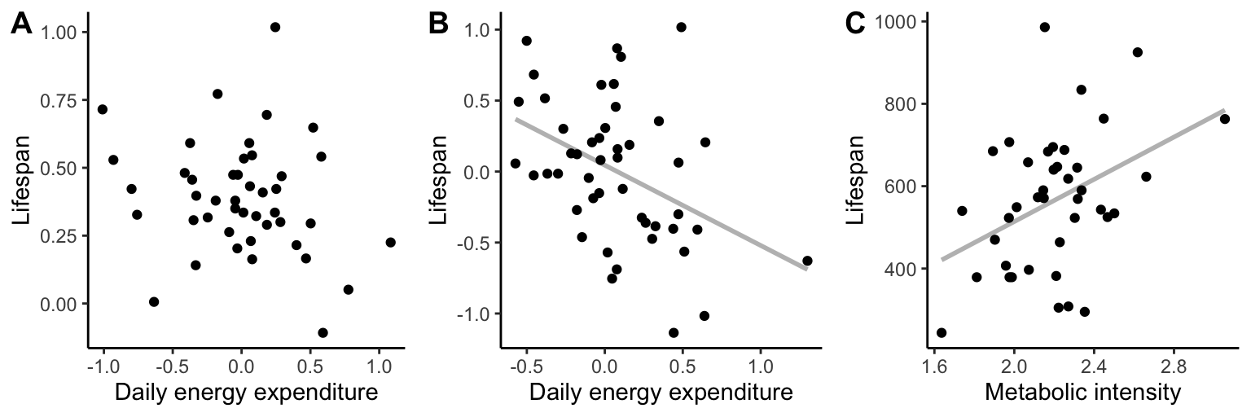
Rate of living theory
Comparison of life-time energy expenditure does not support rate of living theory!

Slide 7
Rate of living theory
Aging as a consequence of accumulation of irreparable damage to cells and tissues
Predictions
Because cell and tissue damage is caused in part by the by-products of metabolism, the aging rate should be correlated with metabolic rate
Because organisms have been selected to resist and repair damage to the maximum, species should not be able to evolve longer life spans
Test 2
Selection on longevity should not lead to longer lifespans

Slide 8
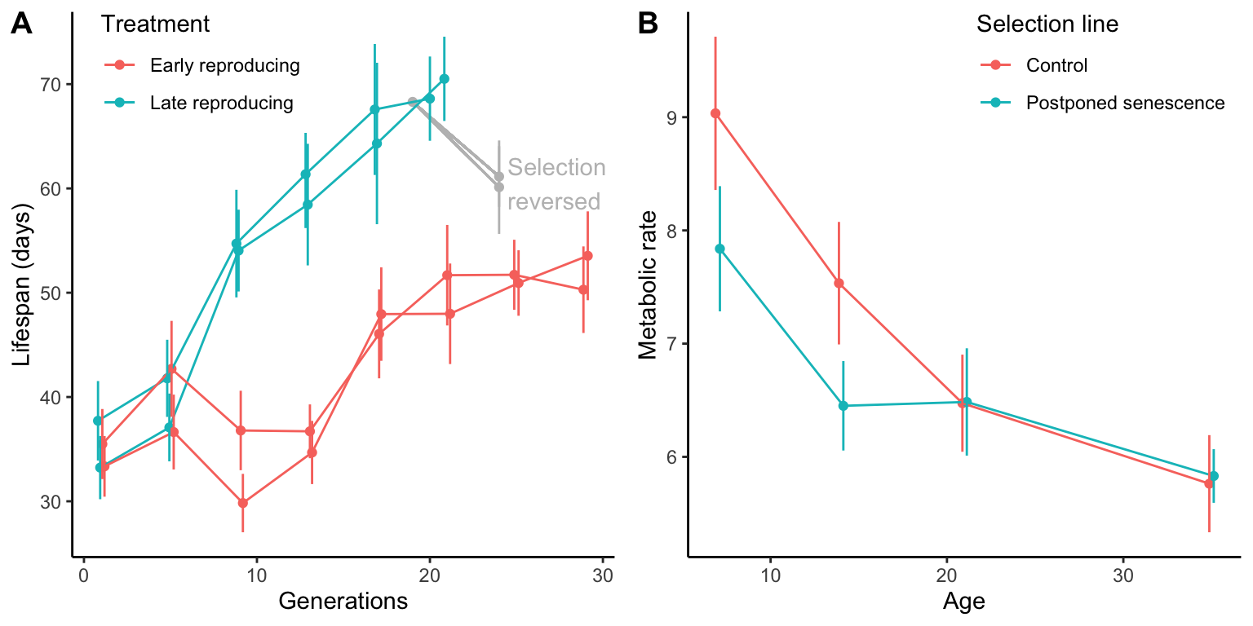
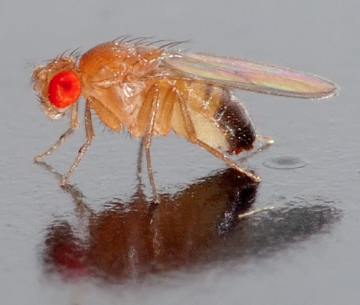
Rate of living theory
Selection experiments do not support rate of living theory!

Slide 9
Evolutionary theories of aging
Under the evolutionary theory, aging is no caused so much by cell and tissue damage itself as by the failure of organisms to completely repair such damage!
Such failure leads to gradual decay
Failure to repair is caused by
Mutation accumulation hypothesis
Why do deleterious mutation that cause failure to repair accumulate?
Antagonistic pleiotropy hypothesis
Is there any evidence that mutations can create tradeoffs between repair and other fitness related functions?

Slide 10
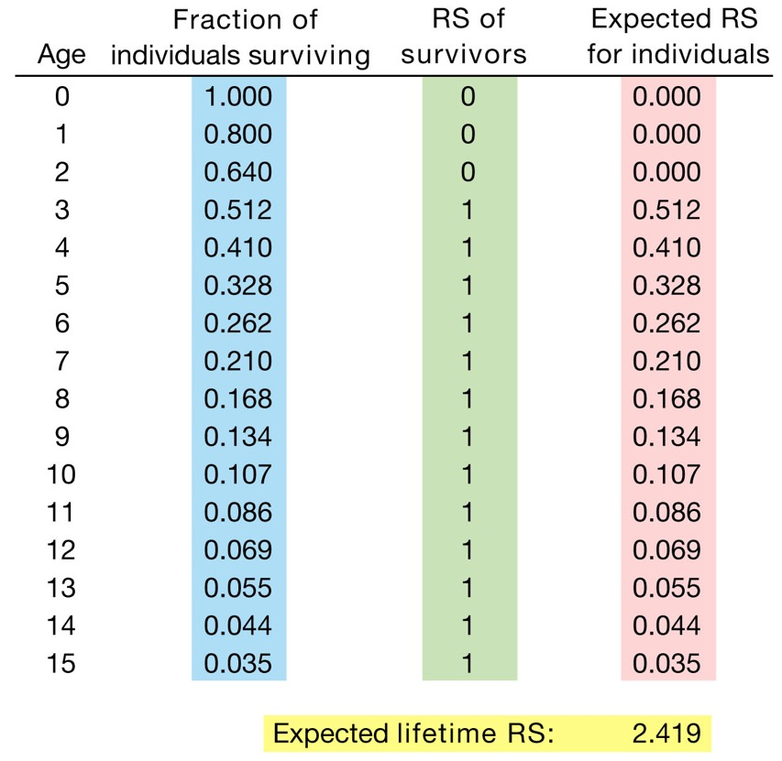
Life tables: basic concept
Calculating average lifetime reproductive success based on survival and age-specific reproductive success
Example:
Survival probability each year: 0.8
Age of maturation: 3
Reproductive success each year: 1
Lifetime reproductive success is the sum of expected RS at each age
How do deleterious mutations impact lifetime reproductive success?
How do mutations that enhance reproduction early in life but are deleterious late in life impact lifetime reproductive success?

Slide 11
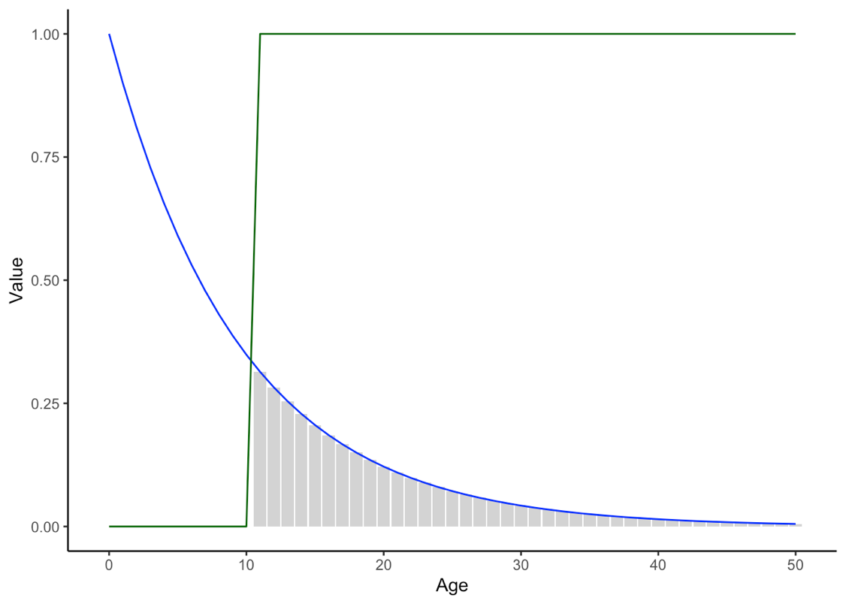
Life tables: basic concept
Calculating average lifetime reproductive success based on survival and age-specific reproductive success
Example:
Survival probability each year: 0.8
Age of maturation: 3
Reproductive success each year: 1
Lifetime reproductive success is the sum of expected RS at each age
How do deleterious mutations impact lifetime reproductive success?
How do mutations that enhance reproduction early in life but are deleterious late in life impact lifetime reproductive success?
Survival
Reproduction
Lifetime reproductive success

Slide 12
Empirical examples
Experimental evolution in Drosophila
What happens to longevity if fly reproduction is limited to early adulthood?
Genetic variation at ageing locus in C. elegans
What happens to alleles that confer longevity under different environmental conditions?
Simple ggplots

Slide 13
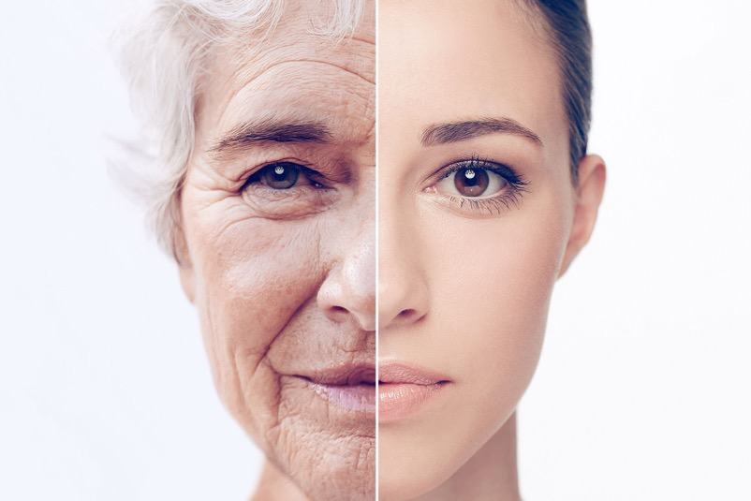
Aging is built into our genomes
Deleterious mutations have accumulated in our genomes of millions of years!
Many have likely only become visible in recent centuries as human lifespans have increased.
Many have and will be sticking around, because carriers actually have higher fitness
We have all evolved to live fast and die young… and we can’t just erase the indelible stamp of natural selection

Slide 15
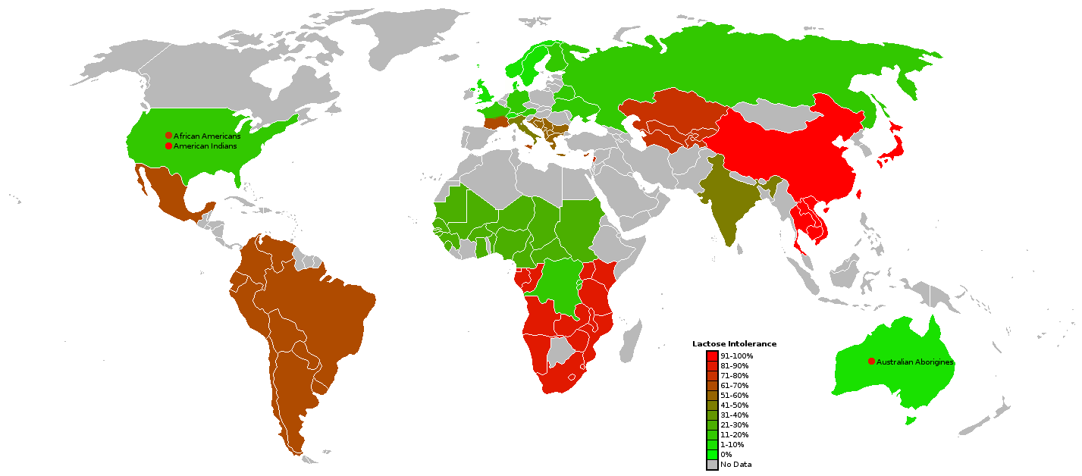
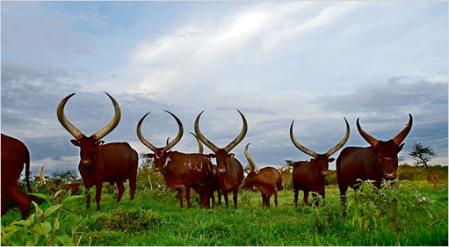
Adaptive trait variation and human health
Lactose intolerance: an evolutionary perspective
Lactase allows for digestion of milk sugar (lactose)
For most mammals, the only source of lactose is breast milk
Lactase production stops after weaning
In populations with a history of keeping domesticated cattle, individuals have a heritable ability to produce lactase as adults

Slide 16
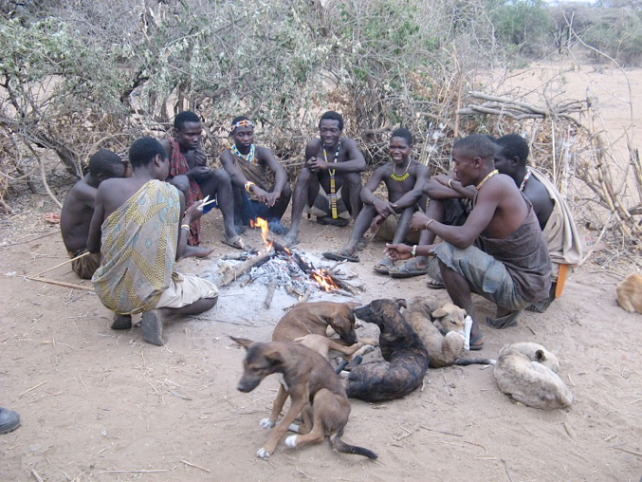
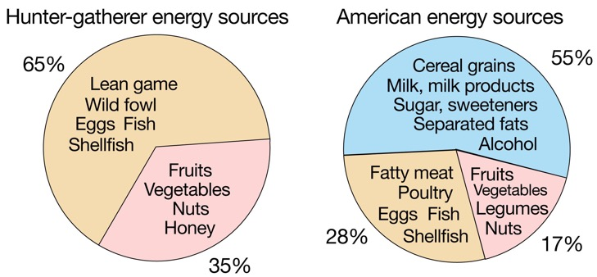
Adaptation to what environment?
Until the advent of agriculture (10,000 ybp), humans lived as hunter-gatherers
Modern urbanites encounter much different environments and have different lifestyles
Different patterns of energy expenditure:
!Kung: Walk ~15 km a day; use energy at 1.5 times the resting metabolic rate
Americans: Walk an average of 0.4 km a day; use energy at 1.2 times the resting metabolic rate

Slide 17
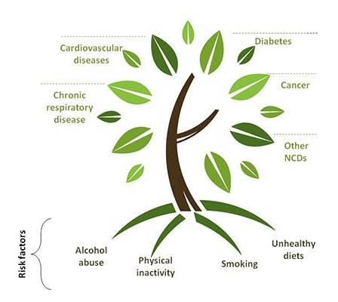
Adaptation to what environment?
Change in lifestyle is correlated with a surge of diseases and conditions absent in hunter-gatherer communities (diseases of civilization)
Are diseases of civilization an indicator of maladaptation? Did cultural change outpace evolution?
If the current environment is different from the environment we adapted to, we can make sense of puzzling traits and recognize ways to reduce risks associated with modern life

Slide 18
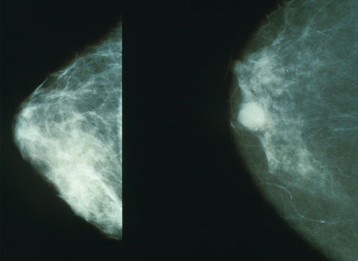
Breast cancer and risks of modern life
Brest cancer occurs in about 12.5% of American women
Caused by genetic and environmental factors
Why do high rates of breast cancer persist?

Slide 19
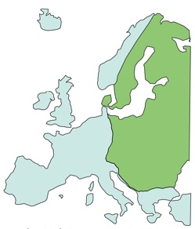
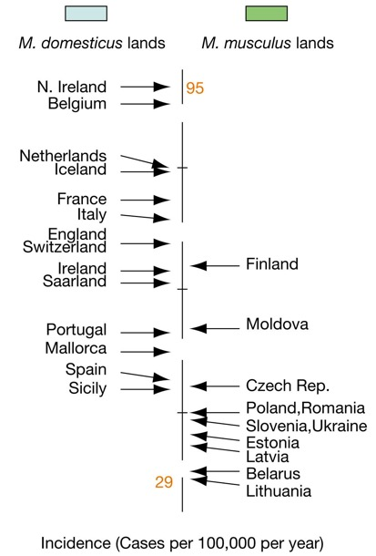
Breast cancer and risks of modern life
Pathogen hypothesis
Mice develop cancer in response to viral infections (MMTV)
Comparisons between normal and breast cancer tissue revealed disproportional incidence of MMTV-like gene sequences
As MMTV is more common in Mus domesticus than Mus musculus, incidence of breast cancer should be higher in countries with the former
Caveats
No virus particles have ever been found in tumor cells
Only 40% of breast tumors exhibit MMTV-like sequences

Slide 20

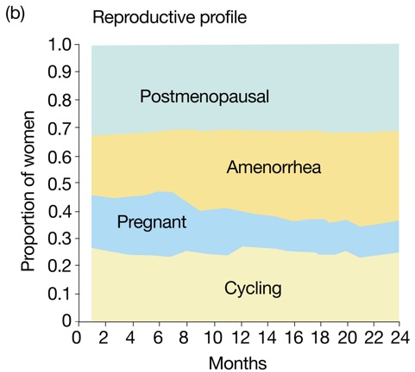
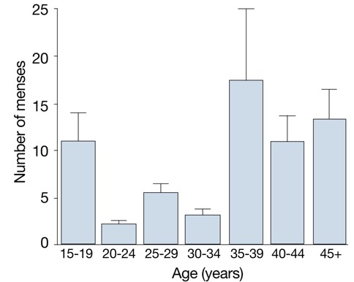
Breast cancer and risks of modern life
Novel environment hypothesis
Breast cancer is associated with menstrual cycling and nursing
Menstrual cycling can stimulate cancer growth because of high estrogen and progesterone levels in postovulatory phase
Is continuous menstrual cycling really normal?
Women’s bodies may not have been selected to tolerate long periods of continuous menstrual cycling!

Slide 21
Risks of modern life led to diseases of civilization
Characters, which evolved under different conditions, now appear maladaptive
Changed environmental conditions may explain the lack of physiological defenses against many diseases of civilization as cultural change outpaces adaptation
Genes underlying diseases of civilization have not been selected against in ancestors, because the different environments prohibited the expression of maladaptive traits
Other examples (often related to diet) include:
Alzheimer’s
Asthma
Chronic liver disease
Type 2 diabetes
Heart disease
Crohn’s disease
Osteoporosis
Stroke
Substance abuse
Anxiety and depression
Obesity

Slide 23


Slide 24
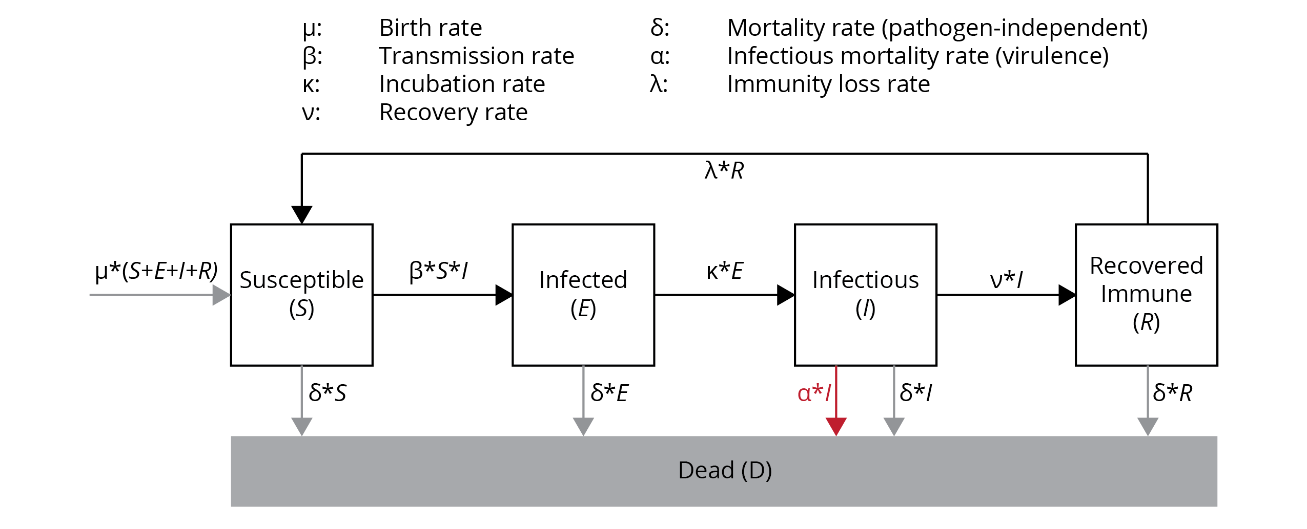
Coronavirus: how does evolution help us combat it?
A crash course in epidemiology

Slide 25
Coronavirus: how does evolution help us combat it?
From epidemiology to pathogen fitness
R₀ is the basic reproductive rate
R₀ measures the average number of secondary cases generated by a primary case in a pool of susceptible individuals (estimated of epidemic growth at the start of an outbreak)
R₀ is equivalent to a pathogen’s fitness (i.e., pathogens try to maximize R₀)
R₀ needs to be >1 for an infection to spread
R₀ can is directly related to epidemiological parameters
β*S
R₀ =
⍺ + ν

Slide 26
Coronavirus: how does evolution help us combat it?
From theory to application
Estimate R₀ for SARS-CoV2
Contrast SARS-CoV2 with the common flu
How can we manage the disease? How can we reduce R₀?

Slide 27
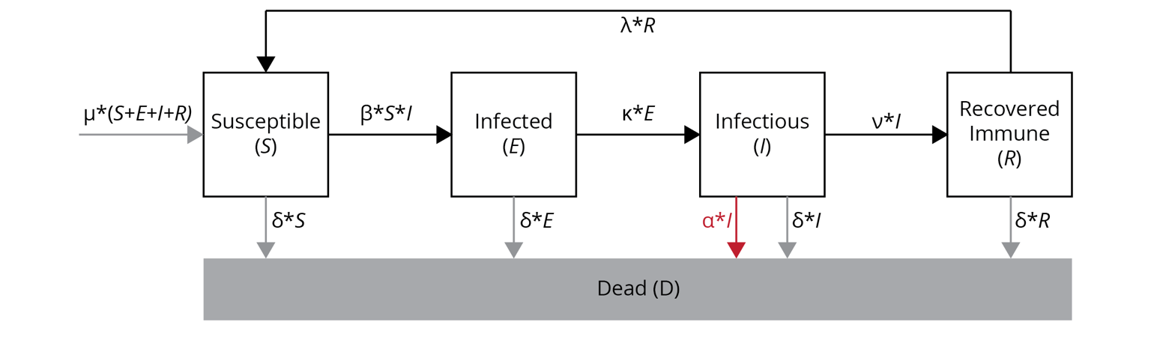
Coronavirus: how does evolution help us combat it?
From theory to application
How can we manage the disease? How can we reduce R₀?
We can directly impact β through our behavior!
We can directly impact N through vaccination!
β *S
R₀ =
⍺ + ν

Slide 28
Coronavirus: how does evolution help us combat it?
Why should we try to minimize R₀, even when many (most?) of us will get this bug eventually?
Delaying the epidemic peak
Reduce burden on the health care system
Diminish overall impact

Slide 29
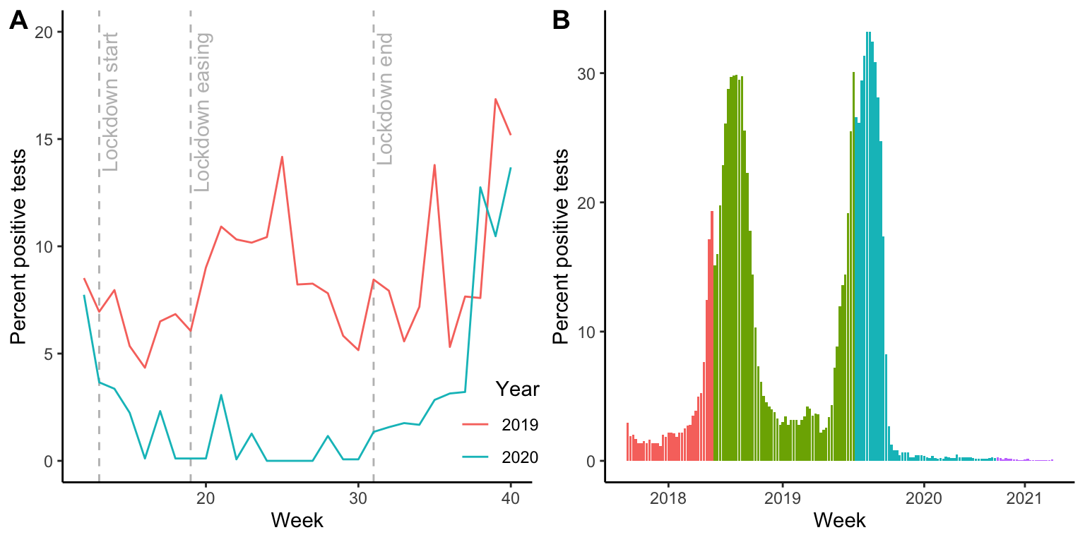
Coronavirus: how does evolution help us combat it?
Does behavior really have such a big impact on disease dynamics?

Slide 30
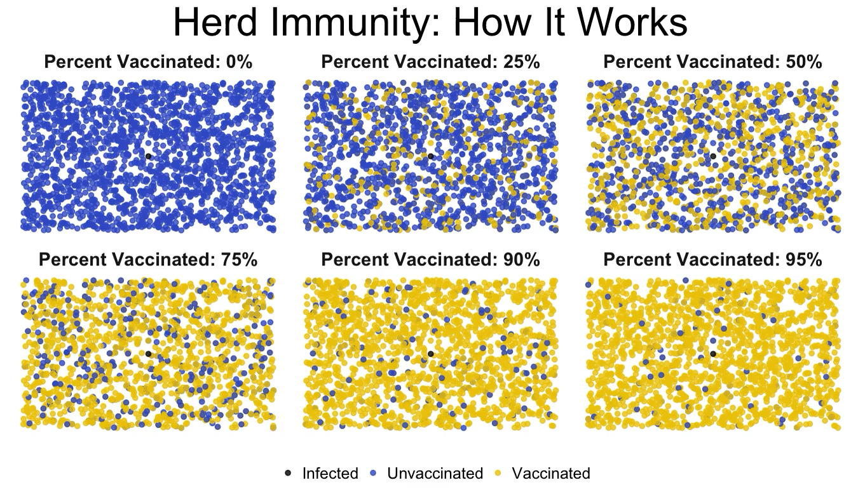
Coronavirus: how does evolution help us combat it?
Why should we try to minimize R₀, even when many (most?) of us will get this bug eventually?
Herd immunity
If enough people are vaccinated, the spread of the pathogen is stopped

Slide 31
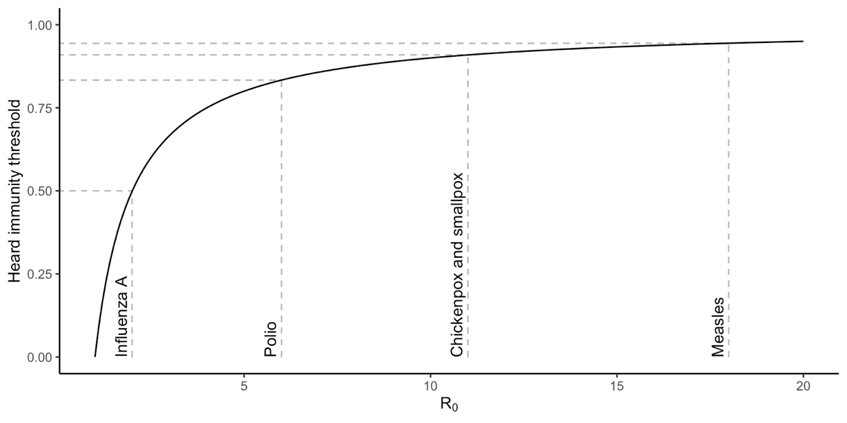
Coronavirus: how does evolution help us combat it?
Why should we try to minimize R₀, even when many (most?) of us will get this bug eventually?
Herd immunity
If enough people are vaccinated, the spread of the pathogen is stopped

Slide 32
Coronavirus: how does evolution help us combat it?
Why should we try to minimize R₀, even when many (most?) of us will get this bug eventually?
What are the evolutionary response of a pathogen that is managed with evolutionary principles?
The virulence of the pathogen will go down, because there is a trade-off between transmissibility and virulence
β*S
R₀ =
⍺ + ν

Slide 33
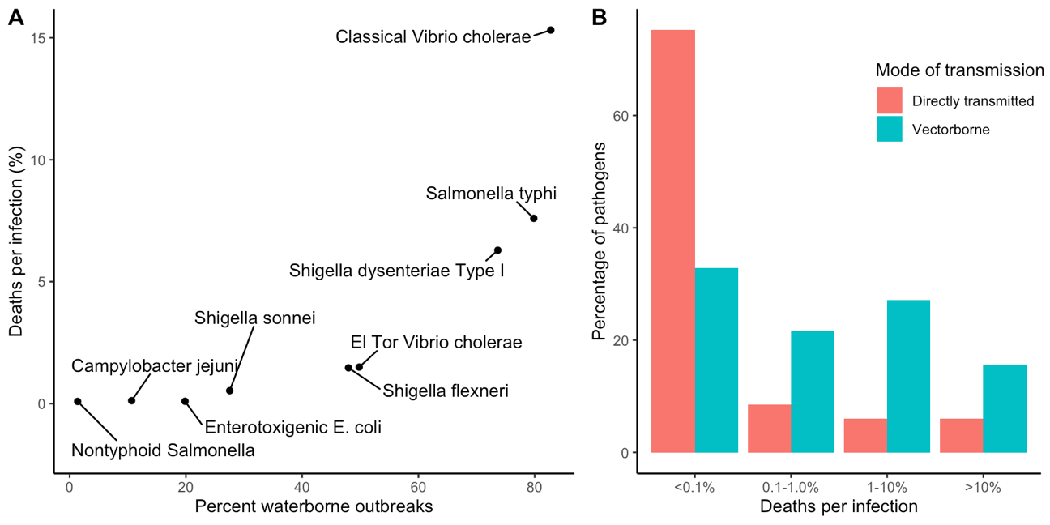
Broader lessons about evolution of virulence
Trade-off between virulence and transmissibility
High virulence for pathogens that are a vector-borne, water borne, or have long survival outside the host!
Basic idea: If pathogen does not need “help” from the host to get transmitted, there is little costs to the pathogen of killing the host!

Slide 34

Broader lessons about evolution of virulence
Management opportunities
Improve availability of clean drinking water to reduce virulence in water borne pathogens
Improve protection from vectors (mosquito nets) to reduce virulence in vector borne pathogens
Use safer sex practices to reduce virulence in sexually transmitted diseases
Stay home, wear a mask, wash your hands… AND GET YOUR COVID SHOT

Slide 35
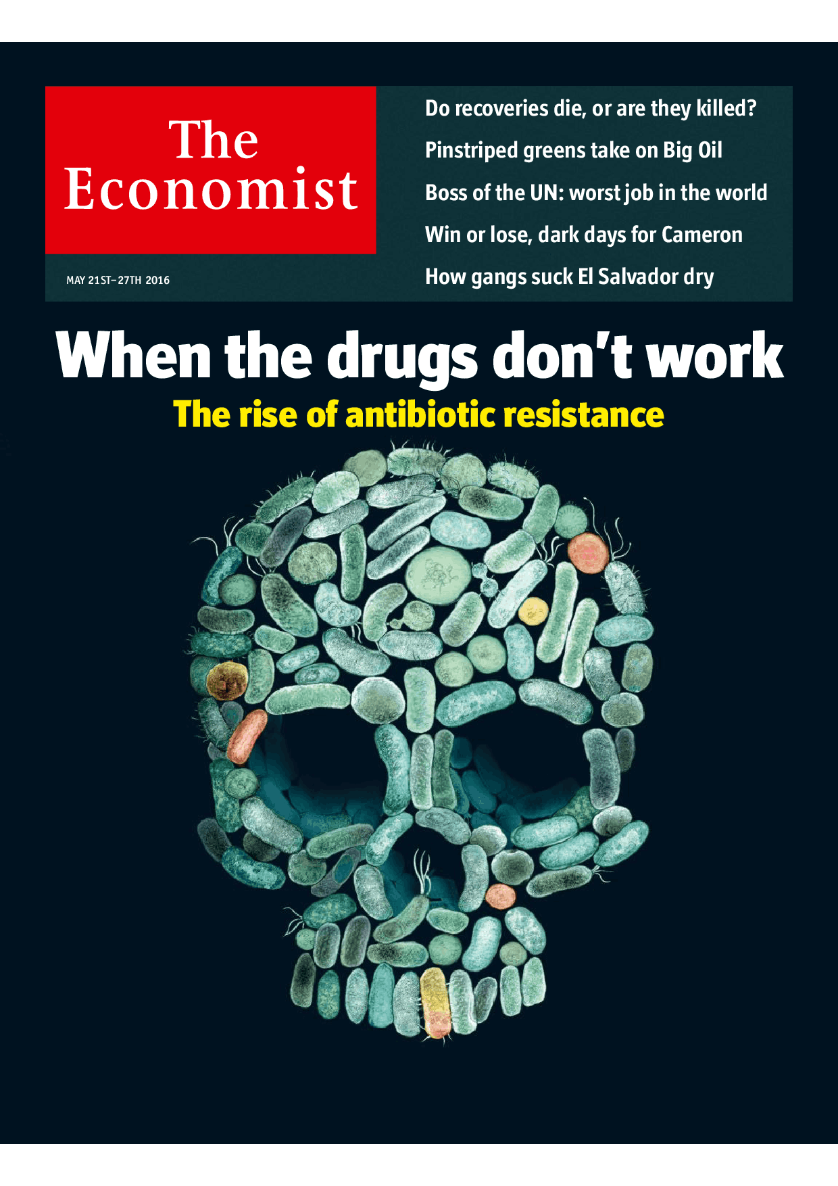
Antibiotic resistance
Rise of multi-resistant pathogens
Slow-down of drug antibiotic discovery

Slide 36
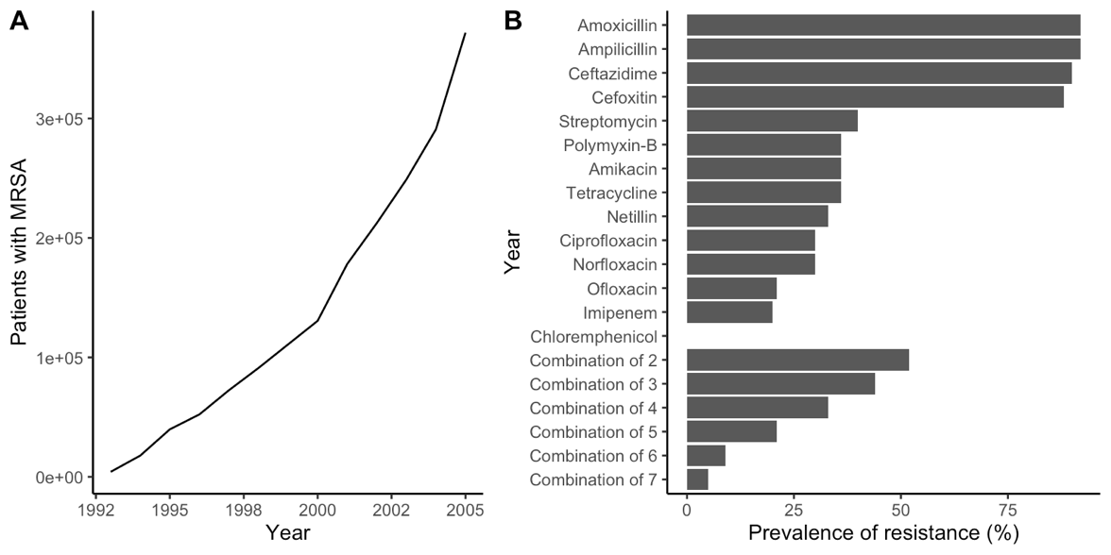
Antibiotic resistance
Antibiotics kill bacteria by interfering with physiological pathways
Antibiotics are a strong source of selection for bacteria populations
Resistance is based on the ability to break down antibiotics or to use alternate physiological pathways
If antibiotic resistance is a heritable trait, we would expect according mutations to increase in frequency when antibiotics are applied

Slide 37
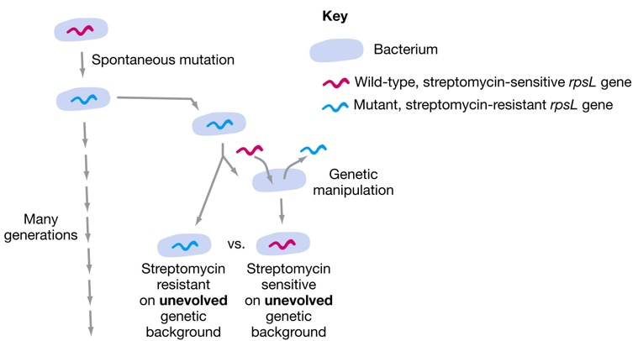
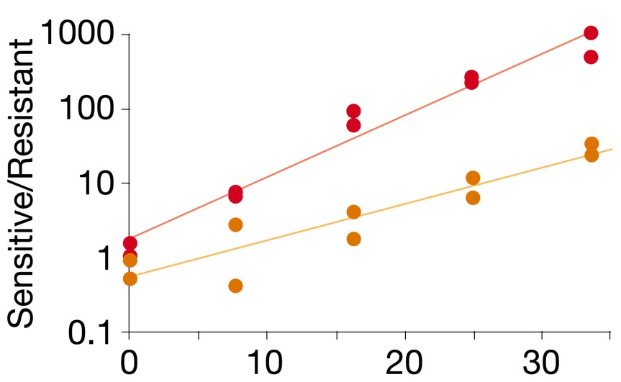
Antibiotic resistance
If the frequency of resistance decreases with restrictive antibiotic use, there must be a costs to resistance!

Slide 38
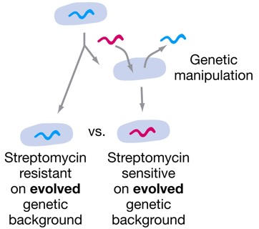
R Exercise
What happens to costs of antibiotic-resistance in the long run?
Solve section 3 in your R Notebook

Slide 39
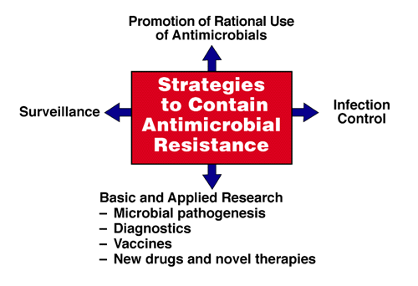
Antibiotic resistance
Since costs of resistance can be alleviated over time, trying to avoid letting bacterial populations evolve resistance is key
Use antibacterial cleaners only when needed to prevent infection of patients with compromised immune systems, but avoid spreading infections by maintenance of proper hygiene
Do not use antibiotics for viral infections (flu) or other cases and antibiotics are not needed
Complete full course of treatment when antibiotics are prescribed
Use narrow targeting antibiotics
Isolate patients with infected with resistant strains

Slide 40
Evolution & human health
“Man still bears in his bodily frame the indelible stamp of his lowly origin.”
C. Darwin

